Slide 1

COBIT
COBIT:
ISACA framework for IT Governance
COBIT 5 helps enterprises to create optimal value from IT by maintaining a balance between realising benefits and optimising risk levels and resource use (ISACA)

Slide 2




COBIT
Strategic Alignment
Value Delivery
IT Governance
Performance Measurement
Risk Management
Resource Management

Slide 3

COBIT
COBIT 5 brings together five principles that allow the enterprise to build an effective governance and management framework (ISACA)
Based on a holistic set of seven enablers that optimises IT investment and use for the benefit of stakeholders (ISACA)

Slide 4
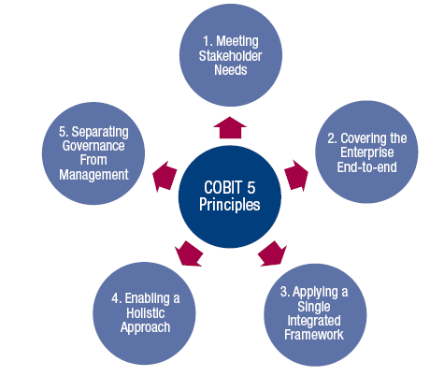
COBIT

Slide 5
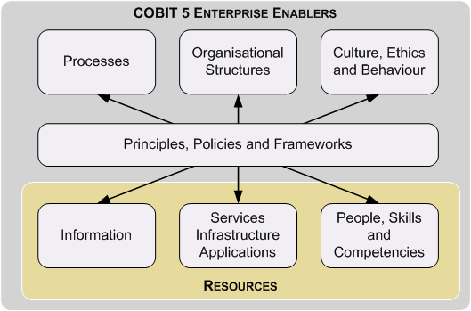
COBIT

Slide 6
COBIT
Governance ensures that enterprise objectives are achieved by evaluating stakeholder needs, conditions & options; setting direction through prioritisation & decision making;

Slide 7
COBIT
…& monitoring performance, compliance and progress against agreed direction and objectives (EDM)

Slide 8
COBIT
Management plans, builds, runs and monitors activities in alignment with the direction set by the governance body to achieve the enterprise objectives (PBRM)

Slide 9
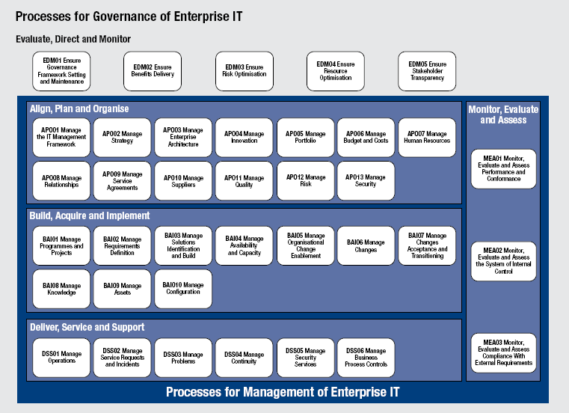
COBIT

Slide 10
COBIT
COBIT 5 is a detailed framework for IT governance developed by ISACA which has principles, enablers, and processes
These tools assist implementers and customer organizations to successfully deploy the framework
Certifiable framework
END

